Slide 1



DEPARTMENT OF COMPUTER SCIENCE & ENGINEERING
SCHOOL OF COMPUTING
10214CS602 MINOR PROJECT -2
WINTER SEMESTER(2023-2024)
REVIEW-2
“IoT-Enabled Cardiac Attack Detection and Intervention”
SUPERVISED BY
PRESENTED BY
Dr. M. Saravana Karthikeyan
1. Pitta Rahul (VTU19191) (21UECT0062)
2. Bhavanam Sarath Chandra Reddy (VTU19151) (21UECT0052)

Slide 2
OVERVIEW
ABSTRACT
OBJECTIVE
INTRODUCTION
LITERATURE REVIEW (SOFT COPY OF PAPERS TO BE LINKED AS HYPERLINK)
DESIGN AND METHODOLOGIES
IMPLEMENTATION
TESTING
INPUT AND OUTPUT
INCLUDE DEMO VIDEO-1 (Till REVEW-1)
INCLUDE DEMO VIDEO-2(Complete Implementation of Project)
CONCLUSION
WEB REFERENCES LINK (TILL REVIEW DATE ALL LINKS TO BE INCLUDED DAY WISE)
REFERENCES

Slide 3
ABSTRACT
Cardiovascular diseases (CVDs) remain one of the leading causes of mortality globally, accounting for millions of deaths each year. Among the various manifestations of CVDs, cardiac attacks, including heart attacks and sudden cardiac arrests, pose significant threats to human life due to their sudden onset and often fatal consequences. Timely detection and intervention are critical in mitigating the severity of cardiac attacks and improving patient outcomes. In recent years, the Internet of Things (IoT) has emerged as a promising technology for healthcare applications, offering innovative solutions to improve patient monitoring, diagnosis, and treatment. Leveraging IoT in cardiac attack detection and intervention presents a transformative approach to addressing this pressing healthcare challenge. At the core of the proposed system are wearable biosensors equipped with advanced physiological monitoring capabilities. These sensors continuously collect vital signs and biometric data, including heart rate, blood pressure, i2c signals from pulse sensor and activity levels, in real-time.

Slide 4
OBJECTIVES
Aim of the project:
The aim of this project is to develop an IoT-enabled system for the early detection and intervention of cardiac attack. And to continually monitor vital signs, evaluate data in real-time, and send timely notifications to patients and healthcare providers.
Scope of the project:
The scope of this project encompasses the design, development, and implementation of an IoT-enabled system for cardiac attack detection and intervention. It includes the integration of wearable biosensors, data analytics algorithms, and intervention mechanisms to enable real-time monitoring, early detection of cardiac events, and timely intervention to mitigate their impact.

Slide 5
TIMELINE OF THE PROJECT
JANUARY | FEBRUARY | MARCH | APRIL
Planning and Preparation | System Development | Testing and Optimization | Validation and Deployment

Slide 6
INTRODUCTION
The initiative to use IoT technology to monitor and identify heart attacks is extremely important to society. It promises to transform cardiac healthcare and maybe save countless lives by utilizing IoT sensors and real-time data processing. For those suffering from cardiovascular disorders, early diagnosis of heart attacks can lower death rates, save healthcare expenses, and enhance overall quality of life. Moreover, proactive self-care practices are encouraged when patients are equipped with real-time insights regarding their cardiac health condition. In addition to improving access to healthcare, especially for marginalized communities, the project provides important data for medical research, which advances the development of cardiovascular disease prevention and treatment methods. In the end, this research has the potential to significantly influence society by advancing patient outcomes, encouraging early intervention.

Slide 7
LITERATURE REVIEW
Author’s Name | Paper name and publication details | Year of publication | Main content of the paper
M. A. Oktay, C. E. Celebi, and M. K. Ozer | An IoT-Based Real-Time Cardiac Monitoring System | 2019 | To know the heart beat and the pulse Realtime
S. A. M. Ali, T. M. Z. Aung, and M. M. Htwe | Design and Implementation of IoT-Based Cardiac Health Monitoring System | 2020 | Open system on to monitoring using IO the card
M. H. Rostamian, A. M. Ghadimi, and H. R. Hassani | Design and Implementation of a Smart IoT-based Cardiac Monitoring System | 2020 | Design of IoT device to monitor heartbeat
J. Alshehri and A. Aljahdali | A Secure and Privacy-Preserving IoT-based Heart Disease Monitoring System | 2020 | Heartbeat monitoring withsecure and privacy prevention.

Slide 8
DESIGN AND METHODOLOGIES
MODULE 1: System Architecture
MODULE 2: Data Processing and analysis
MODULE 3: Realtime Monitoring System
MODULE 4: User Interface Design
MODULE 5: Integration with Healthcare System

Slide 9
MODULE 1: System Architecture
Hardware components include sensors such as the BMP180 barometric pressure sensor, Ublox NEO-6M GPS module, and heart rate pulse sensor, as well as the Arduino Pro Mini microcontroller and display.
- Software components encompass algorithms for data processing, analysis, and real-time monitoring, as well as communication protocols for transmitting data between components.
- This module provides an overview of how these components work together to enable continuous monitoring of cardiac health parameters and timely intervention in case of abnormalities.

Slide 10
MODULE 2: Data Processing and analysis
Algorithms are employed to extract relevant features from the data streams, such as heart rate, blood pressure, and GPS coordinates.
- Sophisticated signal processing techniques, including filtering and pattern recognition, are utilized to identify patterns indicative of cardiac anomalies.
- The processed data is analyzed in real-time to detect abnormal cardiac events and trigger appropriate alerts or interventions.

Slide 11
MODULE 3: Real-time Monitoring and Alerts
Continuous data collection from sensors allows for real-time monitoring of vital signs such as heart rate and blood pressure.
- Algorithms continuously analyze the data streams, comparing them against predefined thresholds or patterns to detect anomalies.
- Upon detection of abnormal cardiac events, the system generates alerts, notifying the user or healthcare providers through visual or audible cues.

Slide 12
MODULE 4: User Interface Design
The user interface provides visualizations of cardiac health data, such as heart rate trends, GPS location, and alert notifications.
- Design considerations include intuitive navigation, clear presentation of information, and customization options to suit individual user preferences.
- The interface enables users to interpret their cardiac health status, view historical data, and take appropriate actions based on alerts or recommendations provided by the system.

Slide 13
MODULE 5: Integration with Healthcare Systems
Integration with electronic medical records (EMR) systems allows healthcare providers to access patient data and monitor their cardiac health remotely.
- The system may also communicate with hospital networks or emergency response services to provide timely assistance in case of cardiac emergencies.
- Compliance with regulatory standards, such as FDA regulations for medical devices, ensures the system meets quality and safety requirements for healthcare applications.

Slide 14
IMPLEMENTATION
Architecture Diagram
Data –Flow Diagram
Use Case Diagram
Class Diagram
Activity Diagram
Sequence Diagram

Slide 15
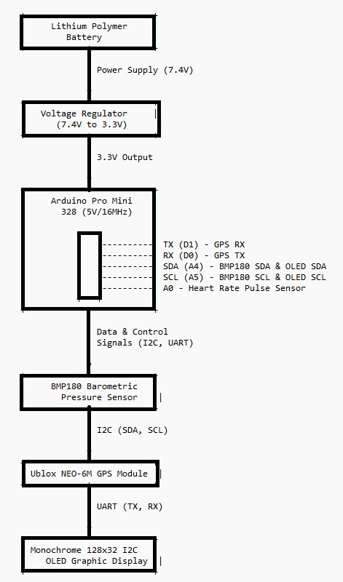
Architecture Diagram
This diagram illustrates the interconnected components of the system, including power supply, microcontroller (Arduino Pro Mini), sensors (BMP180 pressure sensor, Ublox NEO-6M GPS module, and heart rate pulse sensor), and display (monochrome 128x32 I2C OLED graphic display). Arrows indicate the flow of power, data, and control signals between the components.

Slide 16
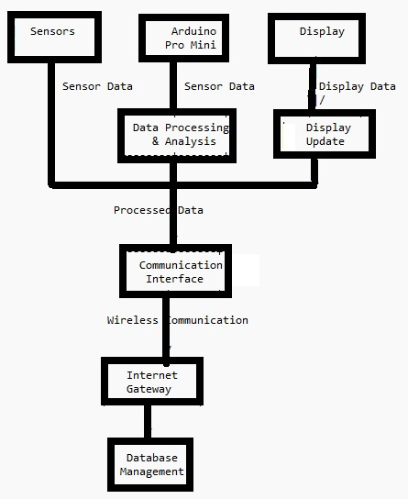
Data –Flow Diagram
Sensors: Capture physiological data such as heart rate, blood pressure, and GPS coordinates.
Arduino Pro Mini: Receives sensor data, processes and analyzes it.
Display: Receives processed data from Arduino for visualization.
Data Processing & Analysis: In the Arduino, algorithms process sensor data, detect patterns, and analyze cardiac health status.
Communication Interface: Manages the communication between Arduino and the internet gateway.
Internet Gateway: Facilitates communication between the IoT device and the database management system over the internet.
Database Management: Stores and manages the collected data for further analysis, retrieval, and integration with other systems.

Slide 17
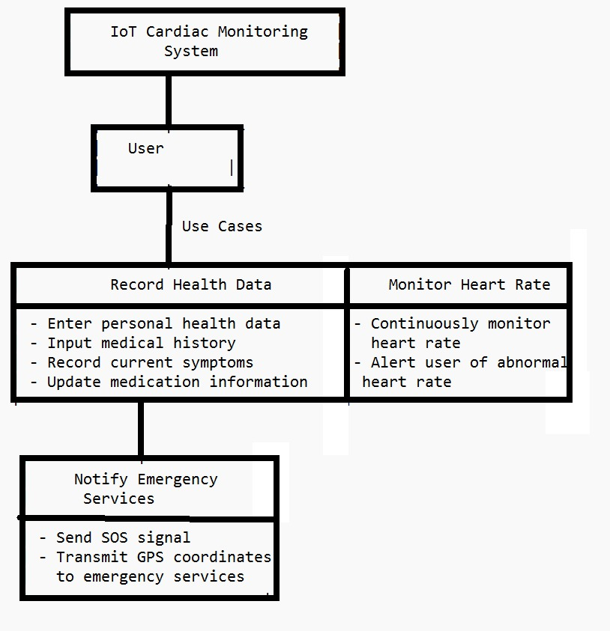
Use Case Diagram
Record Health Data: Users can input and update personal health information, medical history, symptoms, and medication details into the system.
Monitor Heart Rate: The system continuously monitors the user's heart rate in real-time and alerts them in case of abnormal heart rates.
Notify Emergency Services: In case of a cardiac emergency, the user can trigger an SOS signal, and the system transmits their GPS coordinates to emergency services for immediate assistance.

Slide 18
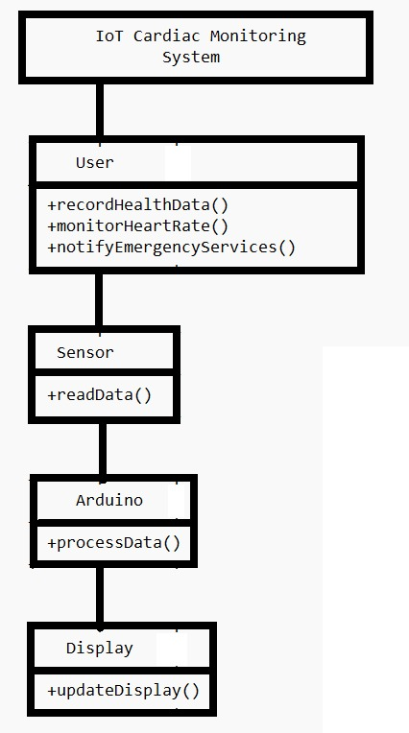
Class Diagram
Eg,
User: Represents the user interacting with the system. They can record health data, monitor heart rate, and notify emergency services.
Sensor: Abstract class representing various sensors (e.g., heart rate sensor, GPS module) used to collect physiological data.
Arduino: Represents the microcontroller responsible for processing the sensor data and managing system operations.
Display: Represents the display component used to visualize information for the user.
readData(): Method to read data from sensors.
processData(): Method to process sensor data and perform analysis.
updateDisplay(): Method to update the display with relevant information for the user.

Slide 19
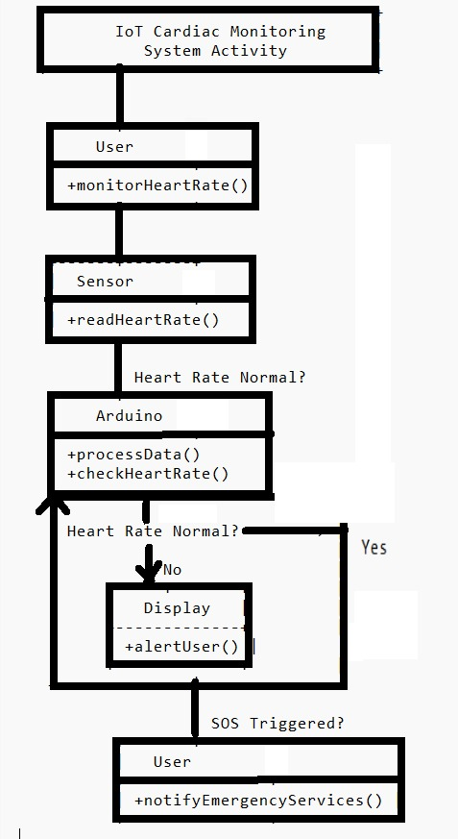
Activity Diagram
The user initiates heart rate monitoring. The sensor reads the heart rate data. The Arduino processes the data and checks if the heart rate is normal. If the heart rate is normal, the system proceeds with normal operations. If the heart rate is abnormal, the system alerts the user through the display. If the user triggers an SOS signal, the system notifies emergency services.

Slide 20
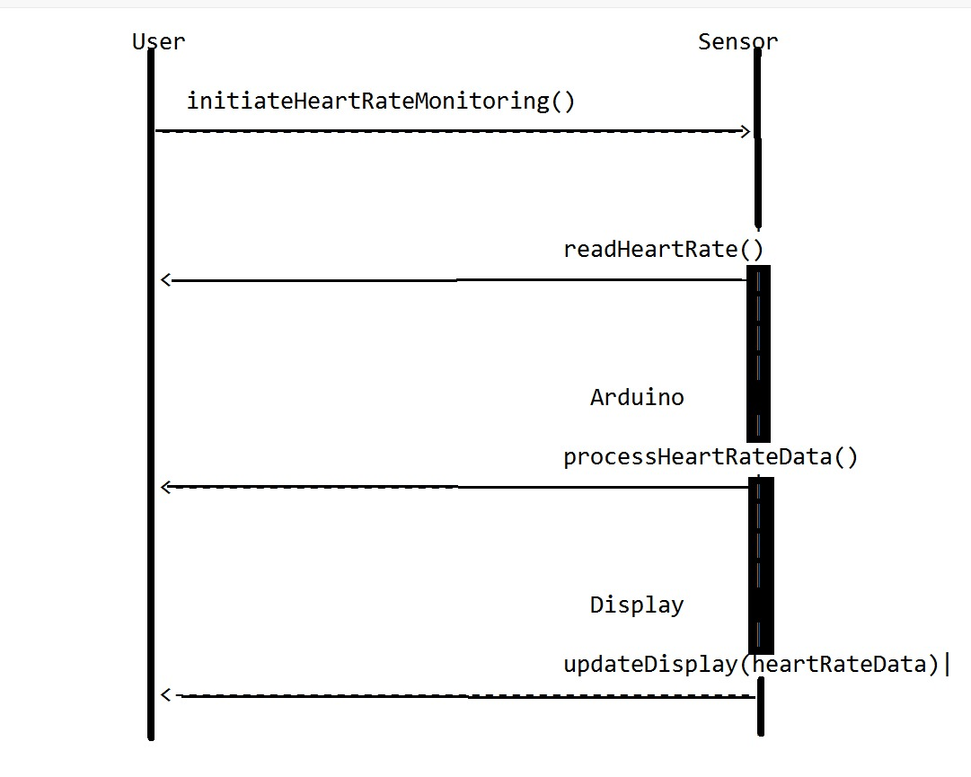
Sequence Diagram
The sequence diagram depicts interactions between the user, sensor, Arduino, and display components. The User lifeline initiates heart rate monitoring. Concurrently, the Sensor reads the heart rate data. Once the heart rate data is read, the Arduino processes it. Concurrently, the Display updates with the processed heart rate data. Each lifeline represents a parallel process occurring independently in the system.

Slide 21
TESTING
UNIT TESTING
INTEGRATION TESTING
FUNCTIONAL TESTING
WHITE BOX TESTING
BLACK BOX TESTING

Slide 22
UNIT TESTING
Description: Unit testing involves testing individual components or modules of the system in isolation. It verifies that each unit of code, such as functions, methods, or classes, behaves as expected.
Purpose: Ensure that each software module and hardware component functions correctly on its own before integration.
Examples: Testing data processing algorithms, sensor calibration, communication protocols.
INTEGRATION TESTING
Description: Integration testing verifies the interactions between different components of the system. It tests the integration of hardware and software components, communication between devices, and data flow between modules.
Purpose: Ensure that integrated components work together seamlessly and meet system requirements.
Examples: Testing data transmission between sensors and microcontroller, integration of display with microcontroller, communication between IoT device and external systems.

Slide 23
FUNCTIONAL TESTING
Description: Functional testing evaluates the system's behavior against its functional requirements. It verifies that the system performs its intended functions correctly, such as monitoring cardiac parameters, detecting anomalies, generating alerts, and displaying information to the user.
Purpose: Ensure that the system meets user requirements and performs its core functions accurately and reliably.
Examples: Testing heart rate monitoring functionality, GPS tracking accuracy, alert generation for abnormal cardiac events.

Slide 24
INPUT AND OUTPUT
In the IoT-enabled cardiac monitoring system project, the inputs consist of various streams of physiological data gathered from sensors integrated into the system. These sensors include the heart rate pulse sensor, barometric pressure sensor, and GPS module, which collectively capture essential parameters such as heart rate, blood pressure, oxygen saturation, temperature, and GPS location. Additionally, user input plays a crucial role, allowing individuals to interact with the system through the user interface. Users can input personal data, update medical history, record symptoms, and trigger emergency alerts as needed. Furthermore, external inputs from healthcare systems, such as electronic medical records (EMR) or hospital networks, enable seamless data integration and communication, enriching the system's capabilities for comprehensive cardiac monitoring.
On the output side, the IoT-enabled cardiac monitoring system provides real-time monitoring data to users, displaying vital signs such as heart rate, blood pressure, and GPS location continuously through the user interface. In case of abnormal cardiac events or emergency situations, the system generates immediate alerts, notifying users and designated caregivers via visual or audible cues. Moreover, the system facilitates the storage and retrieval of historical monitoring data, enabling users to analyze trends and patterns over time. Integration with healthcare systems allows for seamless data sharing and collaboration with healthcare providers, enhancing patient care and treatment outcomes. Overall, the inputs and outputs of the system collectively contribute to its functionality, usability, and effectiveness in monitoring and managing cardiac health.

Slide 25
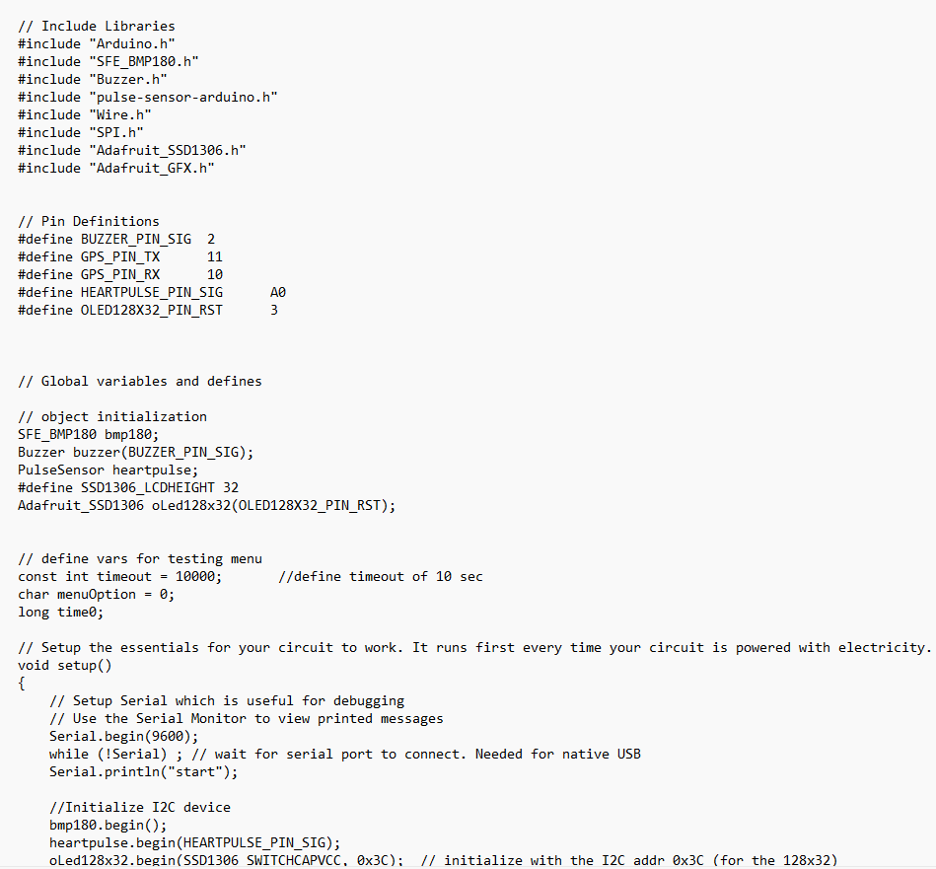
SOURCE CODE

Slide 26
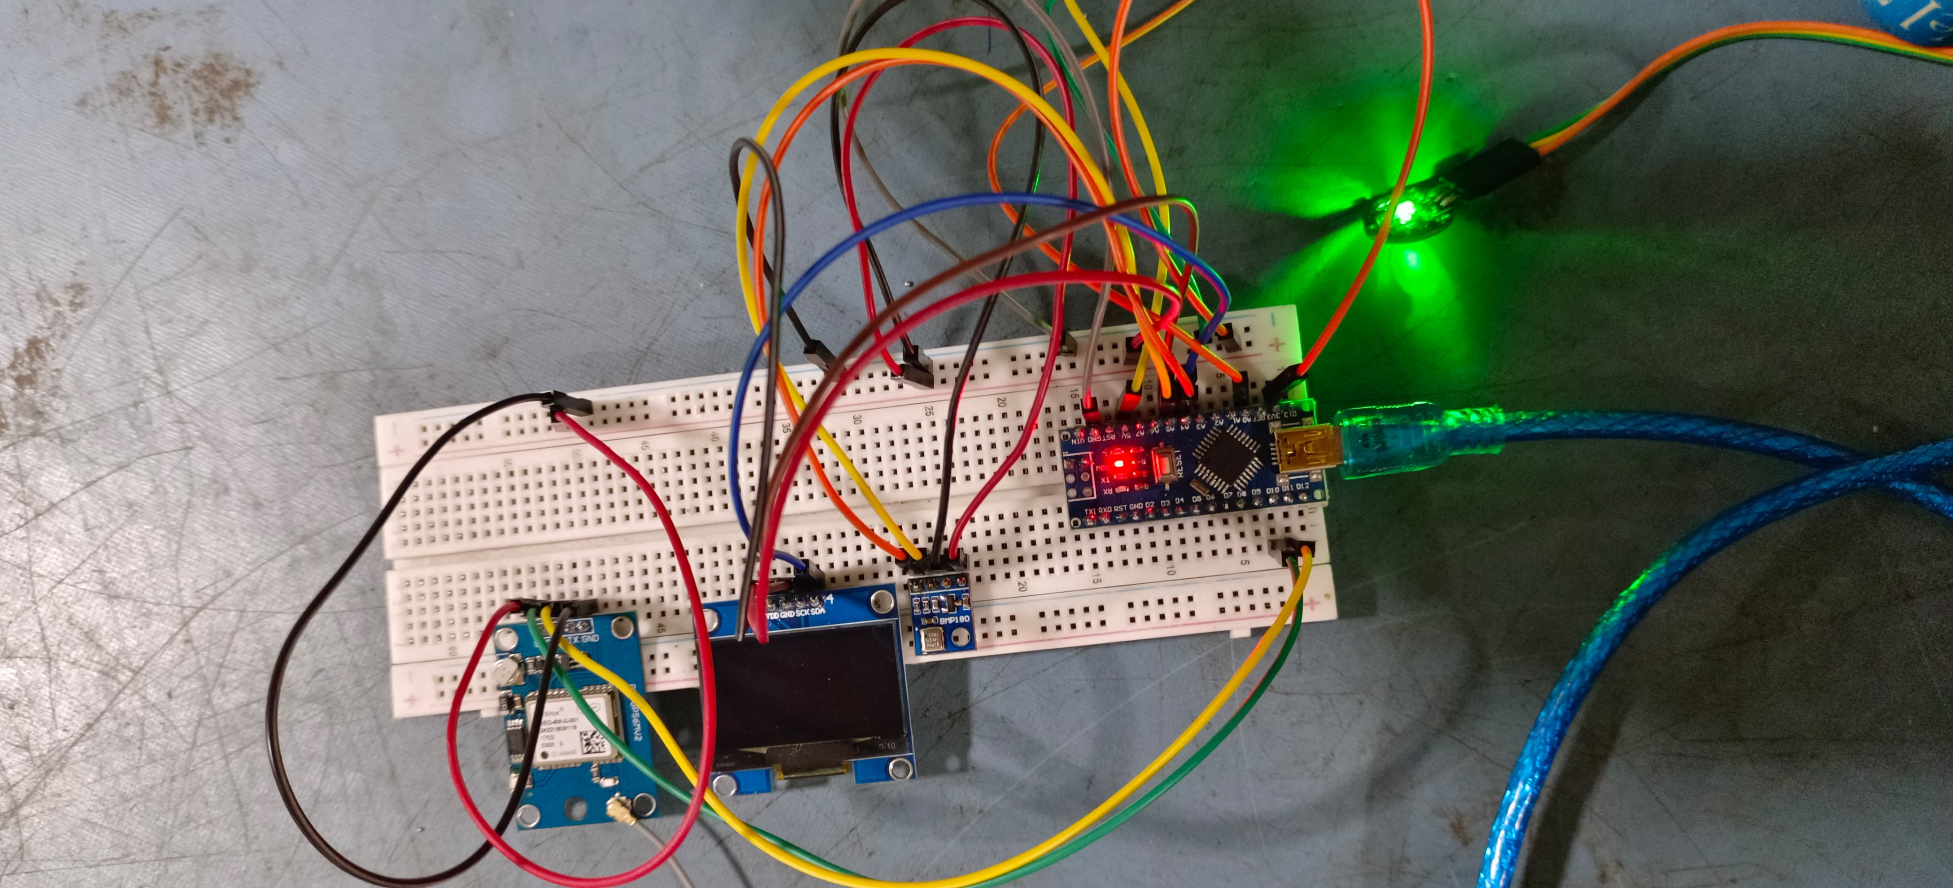
OUTPUT

Slide 27
CONCLUSION
The IoT-enabled cardiac monitoring system presents a promising solution for continuous monitoring of cardiac health parameters, facilitating timely intervention and improving patient outcomes. Through the integration of sensors, microcontrollers, and communication technologies, the system enables real-time monitoring of vital signs such as heart rate, blood pressure, and GPS location. Throughout the development process, various testing methodologies such as unit testing, integration testing, functional testing, white box testing, and black box testing were employed to ensure the reliability, accuracy, and usability of the system. These testing processes helped identify and address potential issues early in the development cycle, leading to a robust and dependable final product.With its user-friendly interface and seamless integration with healthcare systems, the IoT-enabled cardiac monitoring system empowers users to monitor their cardiac health effectively and take proactive measures to manage their well-being. Additionally, the system's ability to generate alerts in case of abnormal cardiac events enhances patient safety and provides peace of mind to users and caregivers alike.
Moving forward, further research and development efforts can focus on enhancing the system's capabilities, such as incorporating machine learning algorithms for predictive analytics and expanding its compatibility with wearable devices and mobile applications. By continually innovating and refining the system, we can advance the field of remote cardiac monitoring and contribute to improved patient care and outcomes in the healthcare domain.

Slide 28
Web references/video links
https://ieeexplore.ieee.org/abstract/document/8614921
https://ieeexplore.ieee.org/abstract/document/9155925
https://iotdesignpro.com/projects/iot-based-heartbeat-monitoring-system-using-nodemcu
https://circuitdigest.com/microcontroller-projects/iot-heartbeat-monitoring-using-arduino

Slide 29
REFERENCES
M. A. Oktay, C. E. Celebi, and M. K. Ozer, "An IoT-Based Real-Time Cardiac Monitoring System," 2019 IEEE 8th Global Conference on Consumer Electronics (GCCE), Osaka, Japan, 2019, pp. 891-892, doi: 10.1109/GCCE46687.2019.9015267.
S. A. M. Ali, T. M. Z. Aung, and M. M. Htwe, "Design and Implementation of IoT-Based Cardiac Health Monitoring System," 2020 IEEE Conference on Open Systems (ICOS), Melaka, Malaysia, 2020, pp. 141-145, doi: 10.1109/ICOS48703.2020.9274296.
M. H. Rostamian, A. M. Ghadimi, and H. R. Hassani, "Design and Implementation of a Smart IoT-based Cardiac Monitoring System," 2020 IEEE 10th Annual Computing and Communication Workshop and Conference (CCWC), Las Vegas, NV, USA, 2020, pp. 0595-0600, doi: 10.1109/CCWC47524.2020.9031004.
J. Alshehri and A. Aljahdali, "A Secure and Privacy-Preserving IoT-based Heart Disease Monitoring System," 2020 IEEE International Conference on Electro Information Technology (EIT), Grand Forks, ND, USA, 2020, pp. 403-407, doi: 10.1109/EIT47822.2020.9150285.
A. D. N. Siñel, N. C. O. Lleno, and J. A. A. Lao, "Development of an IoT-Based Cardiac Monitoring and Alert System for Atrial Fibrillation Detection," 2020 IEEE 12th International Conference on Humanoid, Nanotechnology, Information Technology, Communication and Control, Environment, and Management (HNICEM), Baguio City, Philippines, 2020, pp. 1-5, doi: 10.1109/HNICEM51425.2020.9395688.
M. S. Khan, A. U. Qazi, and A. Zeb, "An IoT-enabled Cardiac Health Monitoring and Management System," 2019 IEEE 3rd International Conference on Sustainable Information Engineering and Technology (SIET), Malang, Indonesia, 2019, pp. 380-385, doi: 10.1109/SIET48337.2019.8945880.

Slide 30
THANK YOU

